Slide 1
System Administration (CE542)
Managing Process & Services
Adapted from slides by Hargyo Tri Nugroho

Slide 2
Intro
Two process types:
Shell job : commands (process) started from command line
Associated with the shell
Interactive process
Daemons : process that provides services
Usually started when the computer is booted
Often (but certainly not in all cases) running with root privileges

Slide 3
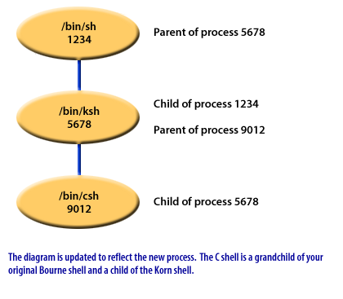
Intro
Parent-Child relationship

Slide 4
Managing Shell Job
When user types command, a shell job is started
Oftenly, shell jobs runs in foreground, but it can run in background too
If a shell job runs in foreground, it will occupies the terminal it has started from until it has finished its work.

Slide 5
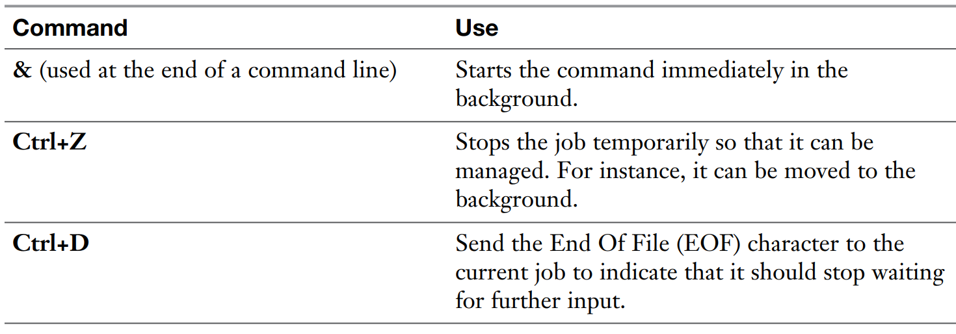
Managing Shell Job

Slide 6
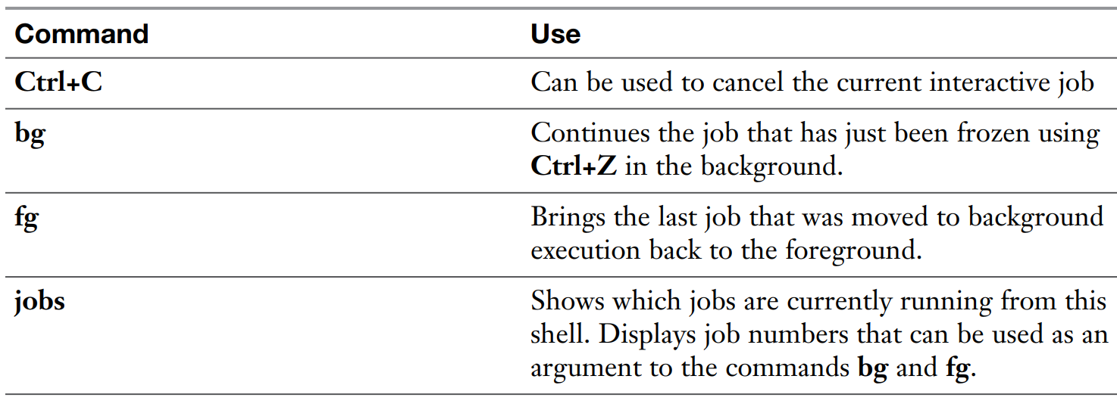
Managing Shell Job

Slide 7
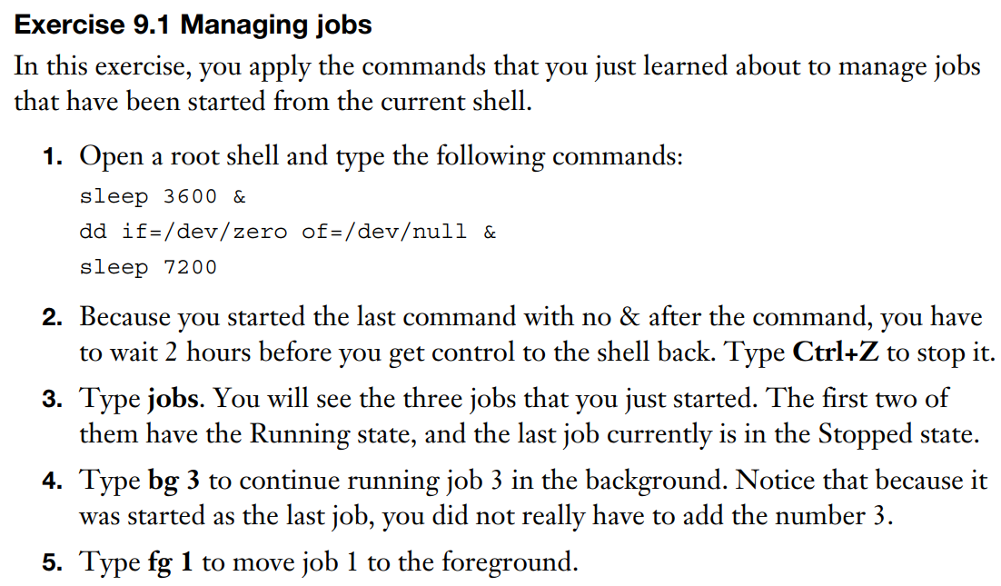
Managing Shell Job

Slide 8
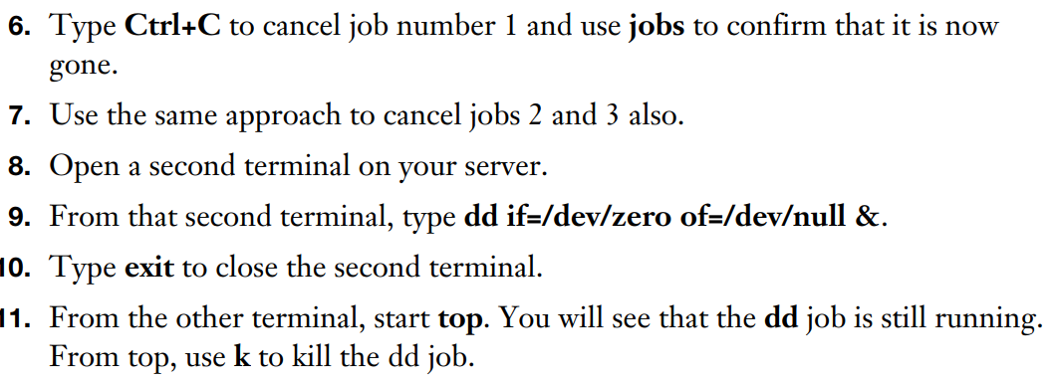
Managing Shell Job

Slide 9
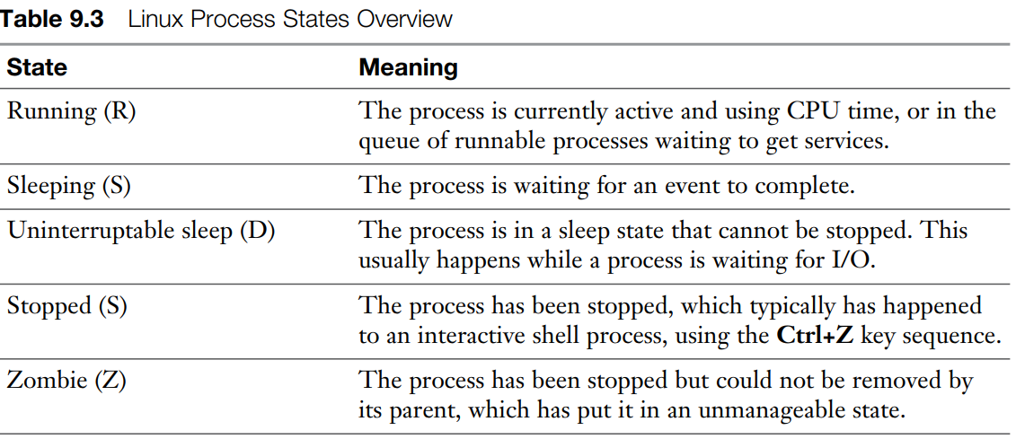
Using top to manage process
top is so great because it gives an overview of the most active processes currently running

Slide 10
Getting Process Information
ps to show the processes that have been started by the current user
ps aux to show short summary of the active processes
ps –ef to see the exact command used to start the process
ps fax to show parent-child relationship between processes
Don’t forget, you have MANUAL

Slide 11
Adjusting Process Priority
nice to start a process with adjusted priority
renice to change the priority of currently active process
r command from top utillity
Default priority = 20
Default nice value = 0
The lower the number the more priority that task gets
Niceness / nice value range = -20 to 19
Applying negative niceness means increasing priority

Slide 12
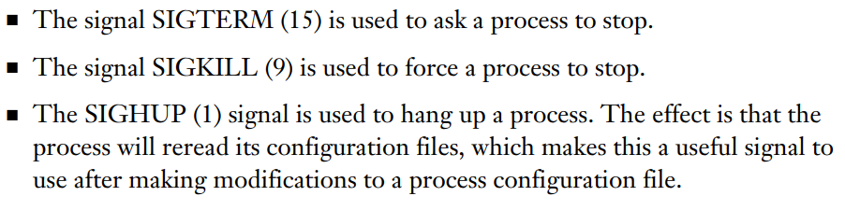
Sending Signals to Processes
Signals in Linux, use man 7 signals for a complete review
We use signals with kill command to kill a process. Basically, using kill -9 is bad idea but it is unavoidable.
Bad practice

Slide 13
Kill related commands
pkill command is a bit easier to use because it takes the name rather than the PID
killall to kill multiple processes using the same name simulatenously

Slide 14
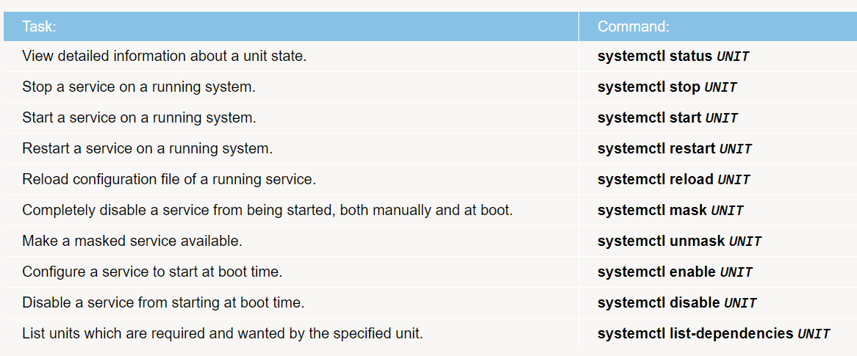
Controlling Services & Daemons

Slide 15
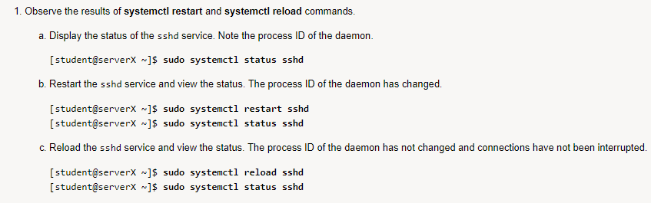
Controlling Services & Daemons
Controlling sshd

